Slide 1


Labs of Physics for Engineers
Young’s ModuluS
Physics Experiment Teaching Center

Slide 2
Aim
1. To estimate Young’s Modulus for a steel wire.
2. To learn how to measure a tiny deformation.

Slide 3
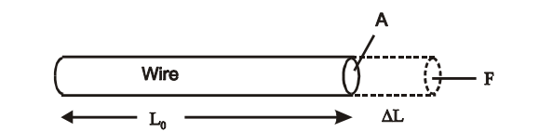
Theory
Young's modulus is a measure of the stiffness of the elastic material. The length of a tested wire is L₀, and F is the magnitude of the force applied perpendicularly to the area A of the wire. The strain or the unit deformation, is represented by ΔL/L₀, here ΔL represents the stretch produced by the force F.
Young's modulus
Fig. 1 A stress F/A on a wre leading to a strain ΔL/L₀
stress
strain

Slide 4
Theory
Once the stress and strain are measured by the equipment, then Young's modulus can be determined for a specific sample in the lab.
Now the problem is focused on how to determine the value ΔL, a very tiny value after the sample is stretched because of the elasticity.
An optical lever is a convenient device to magnify a small displacement and thus to make an accurate measurement of the displacement.

Slide 5
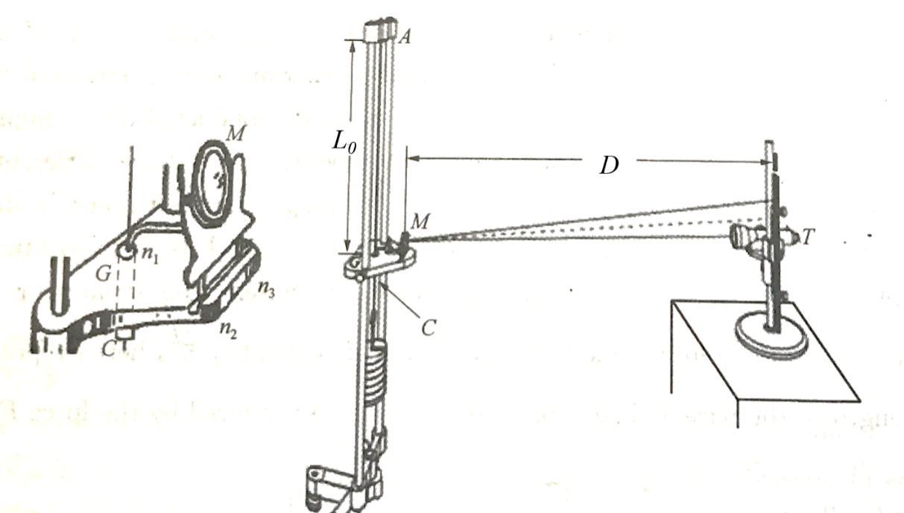
Apparatus
Once the tested wire is stretched by a weight, the mirror consequently tilted up, as a result the reading of the ruler viewed from the telescope is changed as follows. The changes of the reading is proportional to the strain of the stretched wire.
Fig. 2 Measuring ΔL by an optical lever.

Slide 6
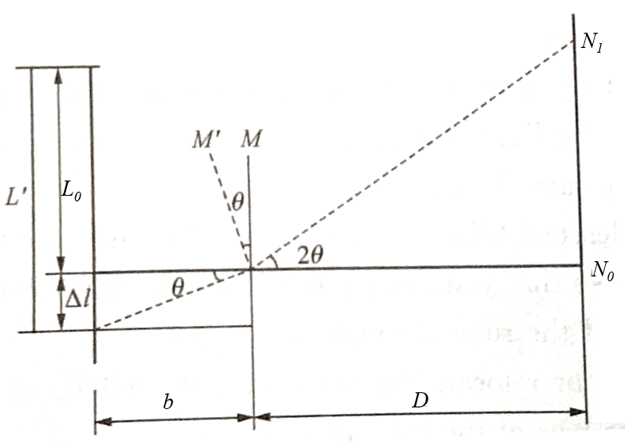
The principle of tiny deformation measurement
b is the perpendicular distance of n₁ to the line of n₂ and n₃, θ is the motion angle
is the difference between the readings on the scale produced by the applied weight
Fig. 3 The relationsip between D, ΔN and ΔL
θ is small so that

Slide 7
Procedure
PART 1 – Aligning the System.
(a) Place the optical lever on the small platform of the tripod with setting the mirror vertically (see Fig.4). Set the telescope and the reading scale at least 1 meter away from the mirror and at about the same height.
(b) Adjust the telescope (height and focus), so that you can see the reflected image of the measuring scale of the ruler through the mirror from the telescope clearly (see Fig.5).
(c) Tilt the mirror or relocate the ruler until the middle of the scale of the ruler coincides with the cross-hair of the telescope.

Slide 8
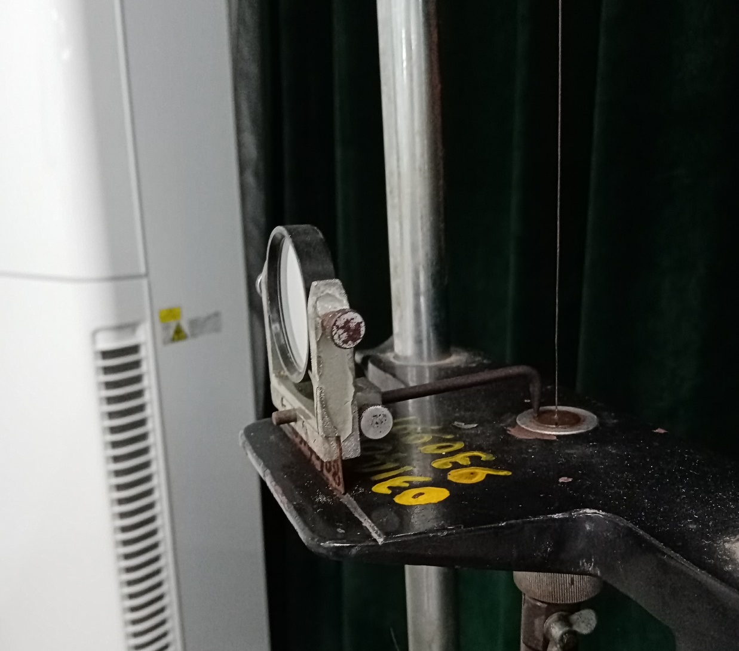
Procedure
mirror
light lever
Fig.4 setting the mirror vertically

Slide 9
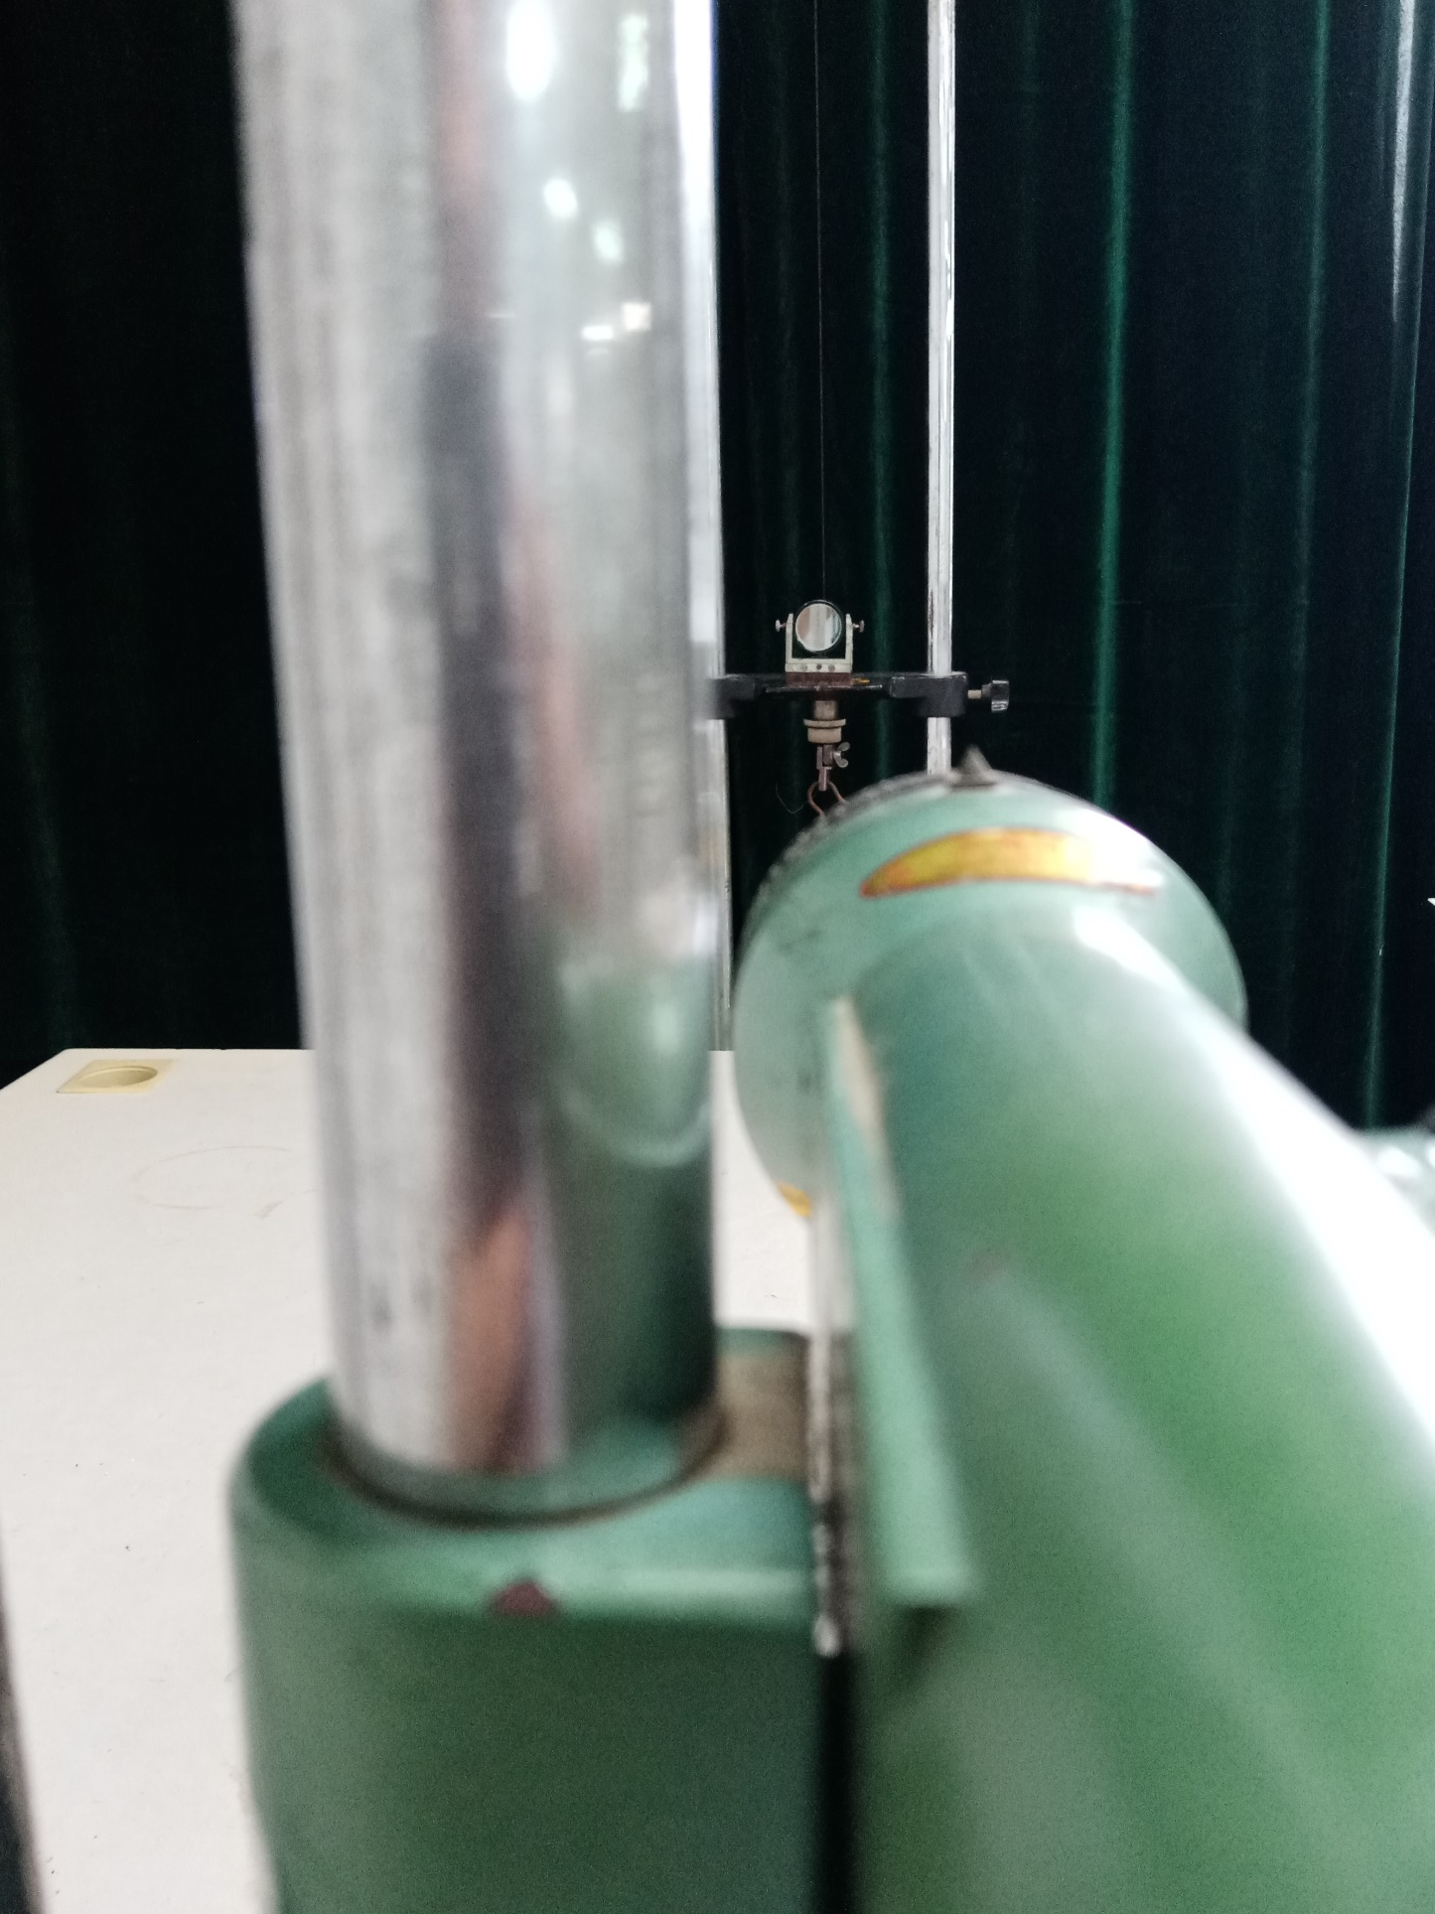
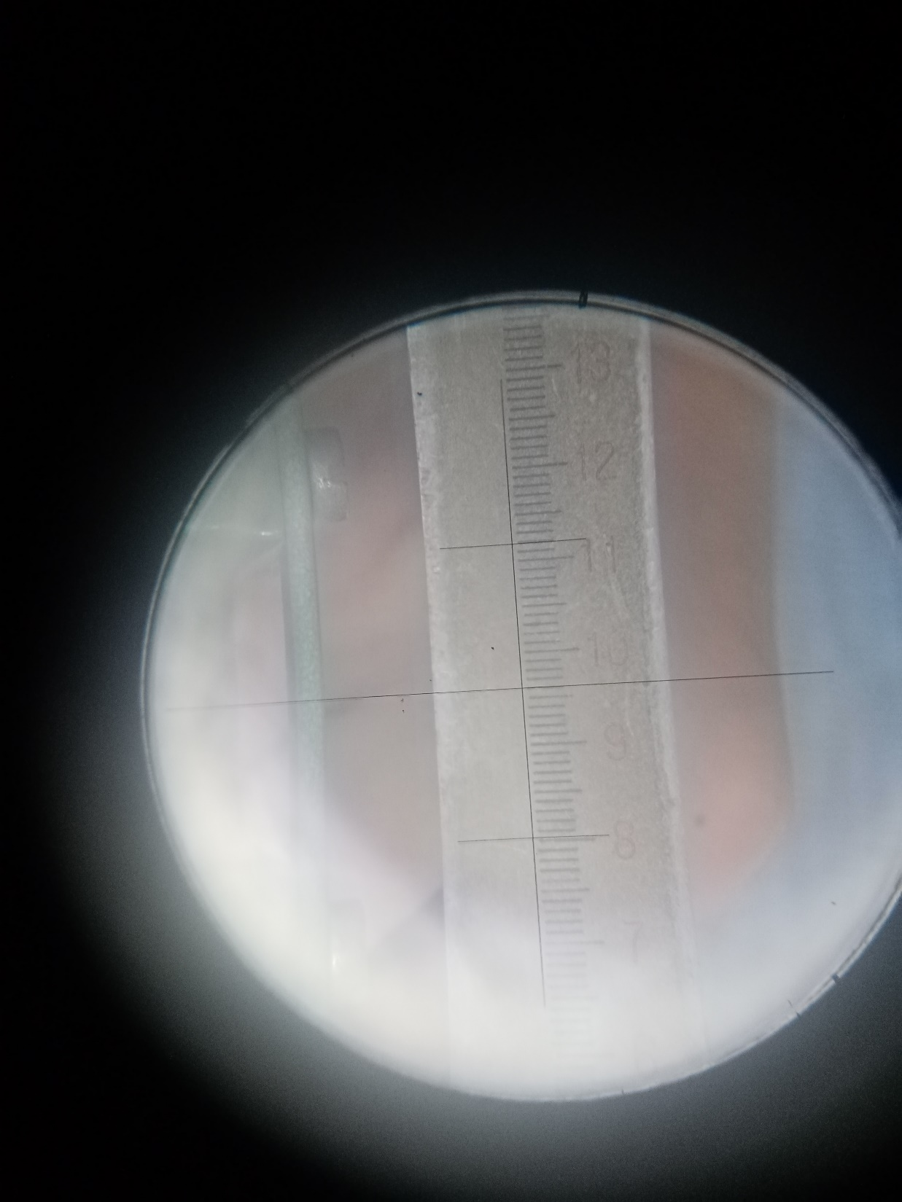
reflected image of the ruler
telescope
cross-hair of the telescope
Fig.5a Reflected image of the ruler through the mirror above the telescope
Fig.5b See the clear reflected image of the ruler from the telescope

Slide 10
Procedure
PART 2 – Determining Young's modulus.
(a) Carefully place 1kg on the weight hanger, keeping on hand under the weight hanger as each weight is added or removed lightly and carefully so that the image is not shifted by an unnecessary impact or vibration. Remember that 1 kg here is the mass for keeping the wire to be stretched. Do not count it as the first mass. (b) Read N₀, the reading of the ruler viewed from the telescope. Wait a minute until the reading shows little change.
(c) Add 1 kg on the hanger, then read N₁ at the new weight. Repeat this procedure until the weight of 7 kg is on the hanger, read N₂-N₇ at the new weight.
(d) Remove 1 kg from the hanger, then read at the reduced weight. Repeat this procedure until the weight of 7 kg is removed from the hanger, read at the new weight.

Slide 11
Procedure
PART 2 – Determining Young's modulus.
(e) Fill all data in the following Table 1. Average these measured values to obtain the difference ΔN for each load.
(f) With the meter stick, measure the length of the wire L₀ between two chucks, and measure the distance D from the mirror to the reading scale.
(g) With the micrometer screw gauge, make five determinations of the diameter of the wire d (five different points along the length of the wire).
(h) With the ruler, measure the light lever constant b.

Slide 12
Data & Calculation
Table 1 Data of stress against strain
M(kg) |  | 0 kg | 1 kg | 2 kg | 3 kg | 4 kg | 5 kg | 6 kg | 7 kg
F=Mg (N) |  | /
Stress: F/A (N/m²) |  | /
N_{i} (cm) | Add weight
 | Reduce weight
 | Average value
N_{i}-N₀ (cm) |  | /
Strain: |  | /

Slide 13
Data & Calculation
Table 2 Diameter of the steel wire Unit：mm
Times | Zero reading d₀ | Measured value d_{i} | Diameter of the wire d
1
2
3
4
5
Average diameter of the wire:

Slide 14
Data & Calculation
Table 3 Measure L₀, D, d, b (see Fig 6)
 | L₀ (cm) | D (cm) | b (mm)
Single measurement

Slide 15
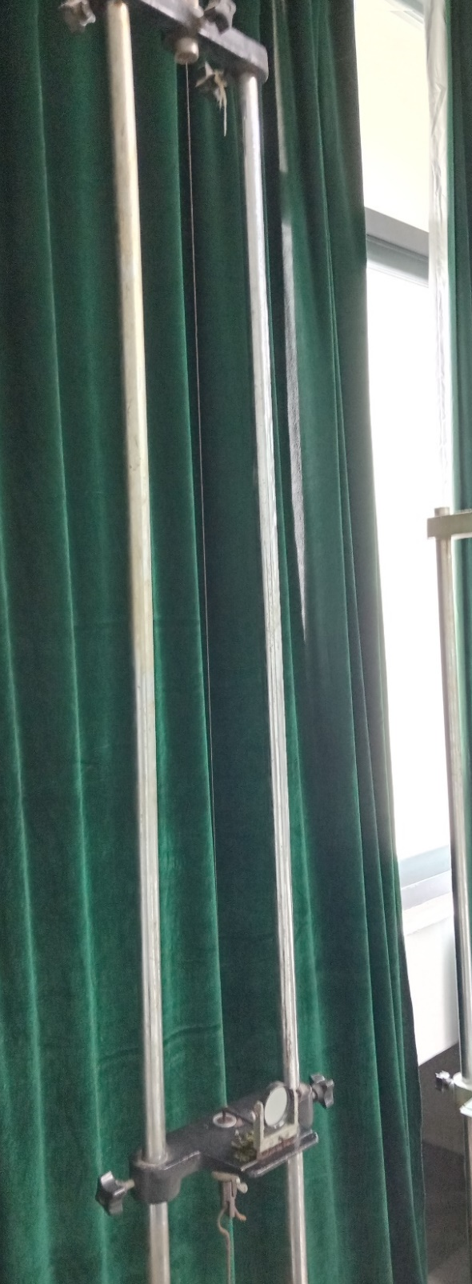
yoke
The steel wire
L₀
yoke
Fig 6a Measurement of the length of the metal wire L₀

Slide 16
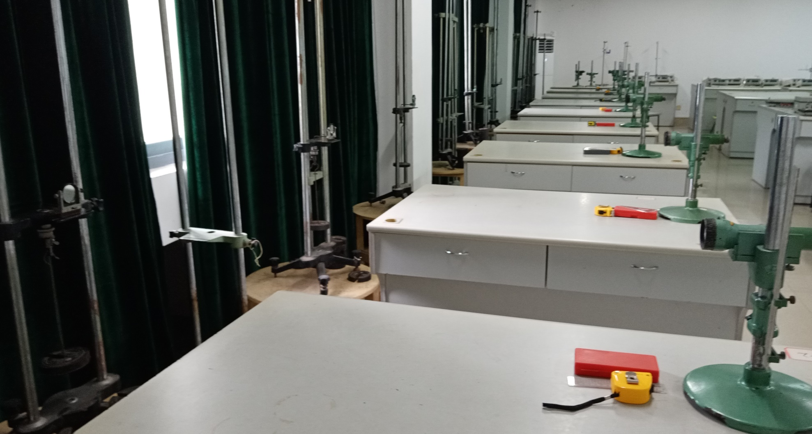
D
Fig 6b Measurement of distance from the mirror to the reading scale D

Slide 17
Results
Calculate the slope of the best-fit straight line based on
the graphic method
(a) Graphing the curve of the stress and stain (based on the calculated results in Table 1). The slope of the stress-stain line is what we need for Young's modulus.
(b) Choose two points from the best-fitted line and calculate Young's modulus. Note that the two points are selected from the two side of the line and are not the measure points.
(c) Comparing with the typical Young's modulus value. Typical value: E_{steel}＝1.80×10¹¹ N/m²
An example is shown in Fig. 7.

Slide 18
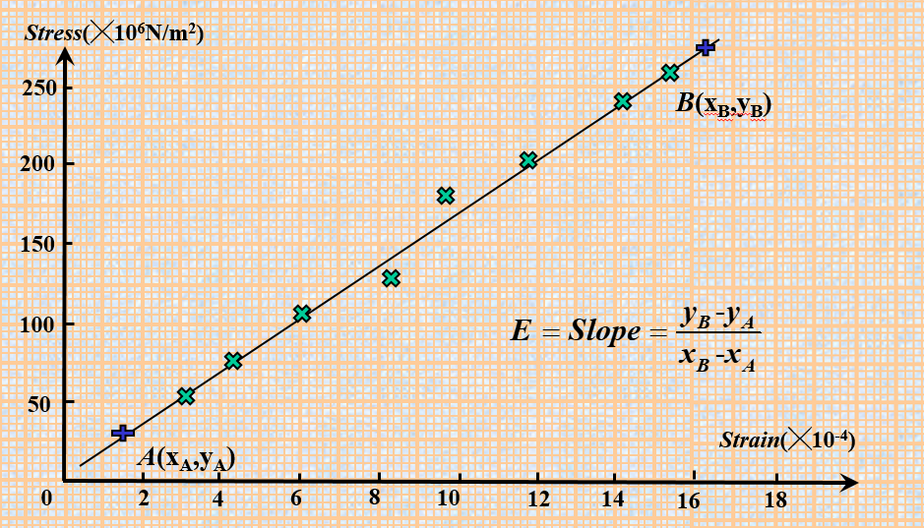
Results
Fig. 7 Calculate the slope of the best-fit straight line based on the graphic method

Slide 19
Conclusions
In no more than 100 words write a succinct summary of what you have done. State the goal and method of the experiment. State your main results, i.e.: What value did you get for Young’s Modulus? Is your result in agreement with the accepted value? If your result is not consistent with the accepted value can you suggest why not?

Slide 20
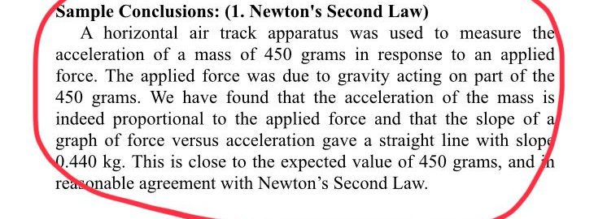
An example for conclusions

Slide 21
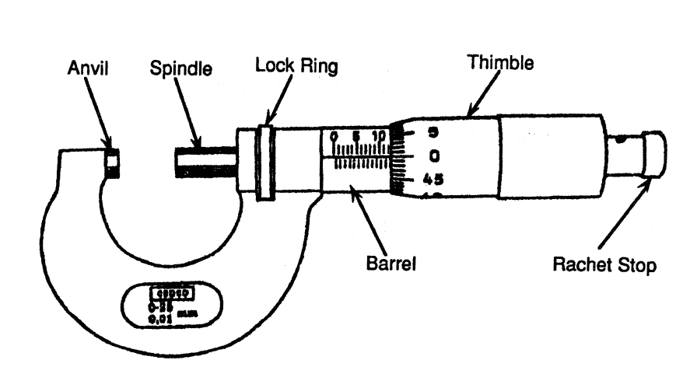
Appendix: Micrometre Screw Gauge
See text in P38
Micrometre Screw Gauge is an instrument which can measure accurately to ±0.001 mm. However, it is limited to objects less than 25 mm in size.

Slide 22
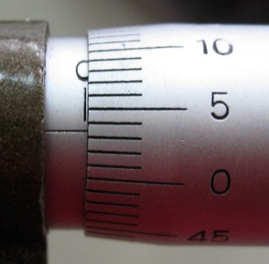
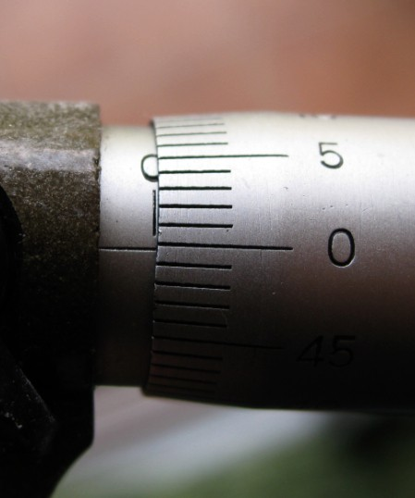
Appendix: Micrometre Screw Gauge
0.3
3.5
positive：0.035
negative: -0.003
Zero reading

Slide 23
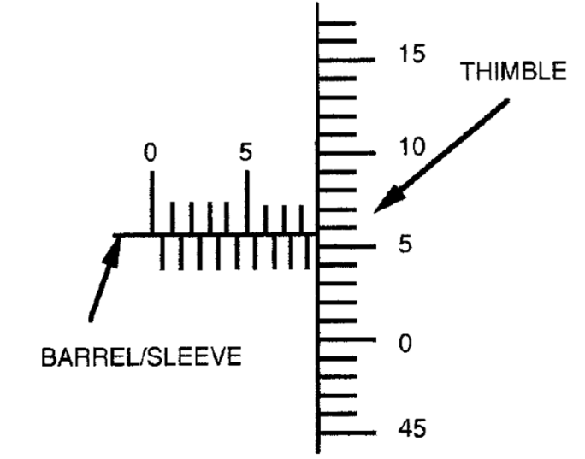
How to read the micrometre
Read the barrel 8.500 mm
Read the thimble 0.058 mm
8.500+ 0.058 mm=8.558mm

